Slide 1
Adversary games

Slide 2
Categories of games
Deterministic (Chess, Go) vs. probabilistic (dice, cards)
Perfect knowledge (Chess, Go, backgammon) vs. partial knowledge (card games)
Two player vs. multiplayer (Risk, Diplomacy)
Individual players vs. team games (bridge, sports)
Zero sum (competitive games) vs. cooperative (the economy)
Alternating moves (Chess, Go) vs. simultaneous moves (Rock, paper, scissors; sports)
Discrete (Chess, Go) vs. continuous (sports)
Known world dynamics (games, sports) vs. learning world dynamics (real world, some video games)

Slide 3
Basic ideas: Extensions of decision theory
Final score. The value of the final state. For Chess, go etc. ±1 (Win or lose). For poker, numeric value.
Assumptions: You will make (what you consider to be) the best move for you. The adversary will make (what you consider to be) the best move for him; in a zero-sum game, this is the worst move for you. Chance will act according to a probability distribution (generally known).
Evaluation function in non-terminal states: Expected value of the state, under the above assumptions.

Slide 4
Game tree
Like a decision tree, but you add a new kind of node, an adversary node.
The value of an adversary node is the minimum of its children.
In a deterministic game: Decision nodes (value is the max of its children) and adversary nodes (value is the min of its children).
In a probabilistic game: Decision nodes, adversary nodes, and chance nodes.
A decision tree of the usual kind (decision nodes, chance nodes) is a game with no adversary played within a probabilistic universe.

Slide 5
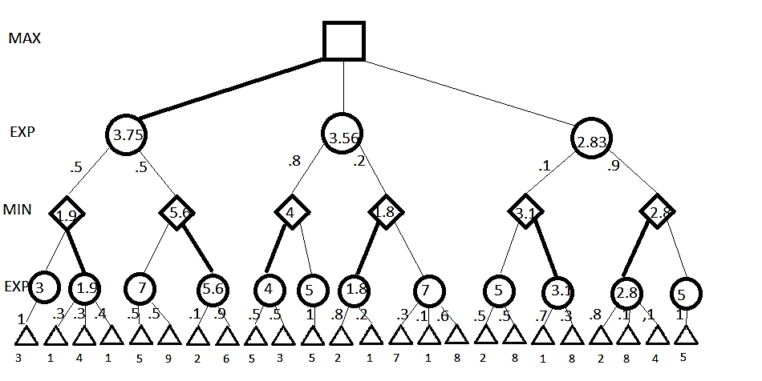
Game Tree: Example

Slide 6
Look ahead
Expand out the tree from the current state (a decision node) to a certain depth, compute the evaluation at the leaves, propagate up to the current state.
Heuristics for expanding only the most promising or important branches (best moves for player and for opponent; most likely branches for chance).
In deterministic games, where these are min-max trees, there are rules that are guaranteed correct: “alpha-beta pruning”.

Slide 7
Checkers
Deterministic, perfect knowledge, two player
Checkers (Art Samuels, 1958).
Used reinforcement learning and self-play
Game-tree lookahead, learned evaluation function over 16 (IIRC) features.
Ran on a machine with 10,000 words of memory and 1 KHz cycle time.
Beat Samuels himself.
Chinook beat the world champion in 1992.
The game was “solved”in 2007 in the sense that it was determined that, with perfect play, it is a draw.

Slide 8
Backgammon
BKG (Berliner, 1980). Handcrafted evaluation function, no lookahead. Beat champion in one game with good luck in the dice.
TD-Gammon (1995). Played at world champion level. Reinforcement learning.

Slide 9
Chess
Deterministic perfect knowledge. State space ~10⁴⁰.
Deep Blue (1997) beat world champion Garry Kasparov.
Game tree search. Evaluation function and game search strategies initially hand crafted then tuned by machine learning from human games.
AlphaZero: Will discuss below.
Considerable impact on human players.
Human-computer team can beat computers without humans (at least as of a few years ago.)

Slide 10
Go
Go: Deterministic, perfect knowledge. State space approximately 3³⁶¹ = 10¹⁷². Search paths can be quite deep. Battles involving a dozen moves on both sides are won by having one stone in the right position. Not monotonic; an extra stone can cost you the battle.
AlphaGo (DeepMind,2016): Beat world champion Go player. Combination of reinforcement learning and deep learning. Trained first on a corpus of human games, then on self-play. Praised for “creative” move. AlphaZero (DeepMind 2017). Learned Go, chess, some other games entirely through self-play. Beat AlphaGo on Go, best chess playing program in chess, best Shogi player on Shogi. (Strictly speaking these were not the same program; the basic architecture was adapted to each game.)

Slide 11
Poker
Probabilistic, partial knowledge, multiplayer, with betting.
Pluribus (Noam Brown and Tuomas Sandholm, 2019) beat human champions in 6 player matches.
Complex, handcrafted algorithm that combined deep learning, reinforcement learning, probabilistic reasoning, and reasoning about the opponent’s knowledge.

Slide 12
AlphaZero
Start with Programming Assignment 3: Reinforcement Learning
Learn the best policy in a Markov Decision problem by experimentation and reinforcement learning.
Start with random play. See what works. There is an external world simulator.
As you learn to play better, focus on good moves, not on bad moves. You are trying to calculate the best move, not to build a classifier that will predict the quality of every move.

Slide 13
Differences between the MDP in Prog3 and Go
The MDP is a probabilistic world with one player. AlphaZero is playing in a deterministic world against an adversary. The adversary is just a copy of itself.
The MDP has so few states that you can record the success rate and compute the policy for each state separately. Go has 3³⁶¹ states.
So rather than a tabulated policy, you need a classifier.
Alpha Go had 2 classifiers: one for policy, one for state value estimation. (It works quite well if it only has one, but it needs both for top performance.)
12 layer convolutional neural network
AlphaZero has one neural network that generates both value and policy.
Use deep learning to train the classifier.
Sophisticated randomized techniques for tree search and evaluation.

Slide 14
Statistics
Trained on 21 million games for Go; 44 million for chess.
5000 first-generation TPUs (tensor processing unit – internal Google product) to generate self-play games and 64 second generation TPUs to do the training.
During play, AlphaZero searches 80,000 positions per second. Stockfish (previous AI chess champion) searches 70,000,000.

Slide 15
Limitation to keep in mind
The standard Go board is 19x19. If a so-so player were given a 20x20 board to play on, my guess is they wouldn’t notice.
I imagine a really good player would notice --- if not immediately, then as the game progressed. But though it might be disconcerting it wouldn’t very much affect their play.
If you give trained AlphaGo or Alpha Zero Go a 20x20 board, it’s not that their play would degrade or even that they would play badly. They would be unable to imagine that such a monstrosity could possibly exist. It’s hard-wired into them that there are 361 input cells and 362 output cells (all 19x19 positions to move, plus “pass”)

